Slide 1
The market garden
September 5, 1944. one of the biggest airborne battles was to take place. both the British and the American armies were to send in Paratroopers To capture German troops across the vital Bridge.

Slide 2
A missed mark.
Although the Americans were planning to land right at the bridge the wind blew them off and most of the troops landed a two miles always from there target. This gave the Germans a time to get ready for an attack.

Slide 3
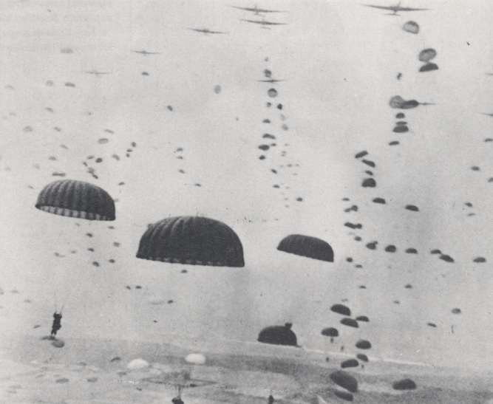
By the time the units reached the bridge . The Germans had prepared them selves for battle. As tanks and men crossed the bridge the Germans attacked.
Operation Market Garden

Slide 4
Will it hold
As the tanks and troops crossed the bridge they saw it started to sag. In some locations holes started to appear. Men worked on the bridge to keep it standing for the battle

Slide 5
Retreat
As the units fired on the German forces tanks showed no mercy on the Nazi soldiers.

Slide 6
It will not stand
Two days later after the battle the bridge collapsed as the troops look down on it they realized that for the first time it had no bars on the bottom for support.

Slide 7
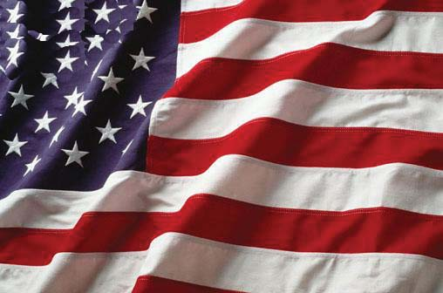
Did we win?
As the Germans were retreating they blasted the bridge killing over hundred soldiers and injured 600. in the end it turned to be a failure.

